Slide 1
Computer Architecture
Peter Youngren Makori
SCT212-0085/2021

Slide 2
Content Layout
Introduction
Classes of computers
Defining Computer Architecture
Trends In Technology
Trend sin power and Energy in Intergrated Circuits
Trends In Cost

Slide 3
1.1 Introduction
Over the past 70 years, computer technology has made remarkable strides. Today, a $500 cell phone can outperform the world's fastest computer from 1993, which cost $50 million. This progress is due to both technological advancements and innovations in computer design.
Historical Performance Improvements
Early Era (1950s-1970s): Performance improved steadily at about 25% per year, driven by both technological progress and better computer architectures.
Microprocessor Era (Late 1970s onwards): The introduction of microprocessors accelerated performance growth to around 35% per year, leveraging advancements in integrated circuit technology.
RISC Architectures
Emergence in the 1980s: RISC (Reduced Instruction Set Computer) architectures focused on simpler instructions and exploiting instruction-level parallelism through techniques like pipelining and caching.
Impact: RISC architectures raised the performance bar, leading to the replacement of older architectures like the Digital Equipment Vax. Intel adapted by translating x86 instructions into RISC-like instructions internally.
Performance Growth and Its Effects
Sustained Growth: From the mid-1980s to 2003, architectural and organizational enhancements led to an unprecedented annual growth rate of over 50% in performance.
Impact on Users: This growth significantly enhanced computing capabilities, allowing modern microprocessors to outperform supercomputers from just 20 years prior.
New Classes of Computers: The improvement in cost-performance led to the emergence of personal computers, workstations, smartphones, and tablets, which are increasingly connected to the internet and large-scale server warehouses.
.

Slide 4
Changes in the Computer Marketplace
Standardized Operating Systems: The adoption of UNIX and Linux reduced the need for object-code compatibility and lowered the cost and risk of introducing new architectures.
Microprocessor Dominance: Improvements in semiconductor manufacturing led to the dominance of microprocessor-based computers across all sectors, from servers to supercomputers.
Software Development
Programming Languages: The dramatic performance improvement allowed for a shift from performance-oriented languages like C and C++ to more productive languages like Java and Scala.
Interpreters and JIT Compilers: Modern development often uses interpreters with just-in-time compilers to maintain productivity while trying to close the performance gap.
Challenges and the End of an Era
Dennard Scaling (ended ~2004): The observation that power density remained constant as transistors became smaller no longer holds. This led to the adoption of multi-core processors to continue performance scaling.
Moore's Law: The prediction that the number of transistors per chip would double every two years has slowed down, impacting the rate of performance improvement.
The Future of Computer Architecture
Specialization: With the slowing of Moore's Law and the end of Dennard scaling, the future lies in specialized architectures that perform specific tasks more efficiently than general-purpose processors.
Domain-Specific Cores: Future microprocessors will likely include cores designed for specific computations, offering better performance and energy efficiency for those tasks.

Slide 5
1.1 Classes of Computers
Changes to the Computer architecture had enabled the development of 5 different computing markets which make up the whole computing scene. Each of these markets are characterized by different application requirements and computing technologies.
They are summarized in the table below.
Feature | Personal Mobile Device (PMD) | Desktop | Server | Clusters/warehouse-scale computer | Internet of things/embedded
Price of system | $100–$1000 | $300–$2500 | $5000–$10,000,000 | $100,000–$200,000,000 | $10–$100,000
Price of microprocessor | $10–$100 | $50–$500 | $200–$2000 | $50–$250 | $0.01–$100
Critical system design issues | Cost, energy, media performance, responsiveness | Price-performance, energy, graphics performance | Throughput, availability, scalability, energy | Price-performance, throughput, energy proportionality | Price, energy, application-specific performance

Slide 6
Personal Mobile Device(PMD)
These are collection of wireless devices with multimedia user interfaces such as cellphones, tablet computers and so on.
Cost is a prime concern for these devices for product since they are the cheaper. Energy concerns are addressed by use of batteries.
Desktop Computing
Is the largest market in terms of dollar terms. It encompasses Desktops and Laptop Computers.
It tends to be driven to optimize price-performance(Measured in terms of compute performance and graphics performance)
Servers
Was conceptualized when desktop computing required large scale and more reliable file and computing services, replacing the traditional mainframe.
The characteristics important are availability, scalability and efficiency, since these are the factors necessary for delivery of services.
Clusters/Warehouse Scale computers
Growth of Software as a Service for applications has lead for the conceptualization of this class. It is composed of multiple Desktop or Server Computers connected by a LAN to act as a single computer.
Important characteristics are Price-Performance and power since they are so large.
Internet of Things(IoT)/Embedded computers
These are computers found in everyday appliances like microwaves, fridges, printers etc
Key characteristics of importance in embedded systems are Processing power and cost for they have a wide range of use and specialty. Performance requirements exist but focus on the min requirents.

Slide 7
Classes of parallelism and Parallel Architectures
There are basically two kinds of parallelism in applications
Data-Level Parallelism(DLP) – Occurs when there are many data items that can be operated on the same time.
Task- Level Parallelism(TLS) – Occurs because tasks of work are created that can operate independently and largely in parallel.
Computer hardware can further exploit the above applications of parallelism in four major ways;
Instruction-Level Parallelism - Exploits DLP at modest levels with compiler help using ideas like pipeliing and at medium levels using ideas like speculative execution
Vector Architectures, GPUs and multimedia Instruction Sets – applies a single instruction to multiple data items in parallel by exploiting DLP .
Thread –Level Parallelism - By either exploiting DLP and TLP in a tightly coupled hardware model that allows interaction between parallel threads
Request-Level Parallelism – Utilizes parallelism among largely decoupled tasks as specified by the programmer or Operating system.

Slide 8
Flynn’s Taxonomy of Parallel Computing
Single Instruction Stream, Single Data Stream (SISD): Represents traditional uniprocessors(Standard sequential processors), which can exploit ILP. Involves techniques such as Superscalar an
Single Instruction Stream, Multiple Data Streams (SIMD): Multiple processors execute the same instruction on different data streams, exploiting DLP. Each processor has its own data memory, but there is a single instruction memory and control processor that fetches and dispatches instructions.
Multiple Instruction Streams, Single Data Stream (MISD): A theoretical category with no commercial implementations.
Multiple Instruction Streams, Multiple Data Streams (MIMD): Each processor operates independently on its own data, targeting TLP. MIMD architectures are more flexible but also more expensive than SIMD.
Many modern processors are hybrids of SISD, SIMD, and MIMD classes, combining different types of parallelism to optimize performance and efficiency.

Slide 9
1.3 Defining Computer Architecture
Understanding Computer Architecture
Imagine you're tasked with designing a new computer. It's not just about making it fast; you also need to balance its performance with energy efficiency while keeping costs, power usage, and reliability in check. This involves diving into various aspects like designing the instruction set, organizing how everything works together, and even dealing with the nitty-gritty of circuit design and cooling systems. It's a complex job that requires knowledge across many different tech areas.
Beyond Just Instructions
Years ago, when people talked about computer architecture, they mostly meant designing the set of instructions a computer understands. But there's so much more to it! It's about creating a system that works efficiently and effectively, from the software running on it to the physical components inside.
Instruction Set Architecture (ISA)
Think of ISA as the language your computer speaks. It's the set of instructions that software uses to communicate with the hardware. Let's look at a few examples to understand this better:
RISC-V: This is a modern, open-source architecture that's simple and efficient. It's like a streamlined, easy-to-understand language that the industry is adopting because it's free to use and modify.

Slide 10
RISC-V Registers and Their Usage
General-Purpose Registers (x0–x31)
Register | Name | Use | Saver
x0 | zero | Constant value 0 | N.A.
x1 | ra | Return address | Caller
x2 | sp | Stack pointer | Callee
x3 | gp | Global pointer | –
x4 | tp | Thread pointer | –
x5–x7 | t0–t2 | Temporaries | Caller
x8 | s0/fp | Saved register/frame pointer | Callee
x9 | s1 | Saved register | Callee
x10–x11 | a0–a1 | Function arguments/return values | Caller
x12–x17 | a2–a7 | Function arguments | Caller
x18–x27 | s2–s11 | Saved registers | Callee
x28–x31 | t3–t6 | Temporaries | Caller

Slide 11
Floating-Point Registers (f0–f31)
Register | Name | Use | Saver
f0–f7 | ft0–ft7 | FP temporaries | Caller
f8–f9 | fs0–fs1 | FP saved registers | Callee
f10–f11 | fa0–fa1 | FP function arguments/return values | Caller
f12–f17 | fa2–fa7 | FP function arguments | Caller
f18–f27 | fs2–fs11 | FP saved registers | Callee
f28–f31 | ft8–ft11 | FP temporaries | Caller

Slide 12
Key Aspects of ISA
Class of ISA: Most modern architectures are general-purpose, meaning they can handle a wide range of tasks. They operate on data stored in registers or memory. Some architectures, like the 80x86, can access memory directly in many operations, while others, like ARMv8 and RISC-V, use specific load and store instructions for memory access.
Memory Addressing: Most computers use byte addressing, which means they access memory in chunks of bytes. Some architectures require data to be aligned in memory for efficiency.
Addressing Modes: These determine how a computer accesses data in memory. Options include using registers, constants, or combinations of both. Different architectures support different modes, affecting their flexibility and performance.
Types and Sizes of Operands: Computers handle data of various sizes, from small 8-bit numbers to large 64-bit ones, including special formats for floating-point arithmetic.
Operations: These include moving data around, performing arithmetic and logical operations, controlling the flow of the program, and handling floating-point math. RISC-V is known for its simplicity in this area.
Control Flow Instructions: These are the instructions that determine the sequence of operations in a program. They include conditional branches, jumps, and function calls. Different architectures handle these slightly differently.
Encoding an ISA: Instructions can be of fixed or variable length. Fixed-length instructions are easier to decode but might take up more space. Variable-length instructions can make programs smaller but are more complex to decode.
Big Picture: Designing a computer isn't just about creating a set of instructions; it's about building a system that's efficient, reliable, and cost-effective. Understanding ISA is crucial because it's the bridge between software and hardware. The rise of architectures like RISC-V shows a trend towards open, collaborative design, reflecting the broader shifts in the tech industry. This humanized version aims to make the concepts more accessible and relatable, focusing on the practical aspects and real-world implications of computer architecture.

Slide 13
1.4 Trends in technology
The key is to create an instruction set architecture (ISA) that can adapt to the rapid changes in technology. Think of it like building a house that can withstand different weather conditions over time. Successful designs, like the IBM mainframe, have managed to do this for decades.
The Technologies Driving Change
Integrated circuit Logic technology:
Historically, we've seen the number of transistors on a chip double about every two years, thanks to Moore's Law. But lately, this pace has slowed down, and it's taking longer for each new generation to double in capacity.
Semiconductor Memory (DRAM):
DRAM is what we use for the main memory in computers. Its growth has also slowed down significantly. It used to quadruple in capacity every three years, but now it's much slower.
Semiconductor Flash Memory:
Flash memory is what's used in devices like smartphones and tablets for storage. It's gotten much cheaper and more capacious over time, increasing by about 50%–60% each year.
Magnetic Disks Technology:
Hard drive technology has improved in density over the years, but recently, the improvements have slowed down. New techniques like Heat Assisted Magnetic Recording (HAMR) are being explored to keep pushing the limits.
Networking:
Network speeds have improved tremendously, and this is crucial for how fast data can move around. The advancements in networking are covered more in-depth in other resources.

Slide 14
Performance: Speed vs. Efficiency
Bandwidth and Latency:
Think of bandwidth as how much data can be moved at once, like the width of a highway. Latency is how long it takes to get from point A to point B, like the time it takes to drive through traffic.
Microprocessors and networks have made huge strides in both speed and efficiency. However, for memory and storage, the improvements in speed haven't been as dramatic.
The Challenge of Wiring
Transistors vs. Wires : As we pack more transistors onto a chip, the wires connecting them become a challenge. While transistors get faster as they get smaller, the wires don't improve at the same rate. This creates a bottleneck, making it harder to keep everything running smoothly.
Designing for the Future
Anticipating Change: Designers need to think ahead and plan for future technological advancements. They have to create systems that can take advantage of new technologies as they become available.
Over the years, reaching certain milestones, like fitting more components onto a single chip, has led to major breakthroughs in design, such as multi-core processors and better caching systems.

Slide 15
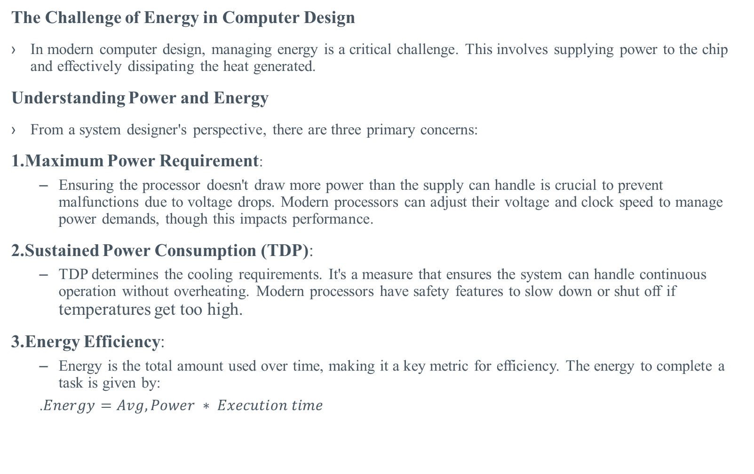
1.5 Trends in Power and Energy in Integrated Circuits
The Challenge of Energy in Computer Design
In modern computer design, managing energy is a critical challenge. This involves supplying power to the chip and effectively dissipating the heat generated.
Understanding Power and Energy
From a system designer's perspective, there are three primary concerns:
1.Maximum Power Requirement:
Ensuring the processor doesn't draw more power than the supply can handle is crucial to prevent malfunctions due to voltage drops. Modern processors can adjust their voltage and clock speed to manage power demands, though this impacts performance.
2.Sustained Power Consumption (TDP):
TDP determines the cooling requirements. It's a measure that ensures the system can handle continuous operation without overheating. Modern processors have safety features to slow down or shut off if temperatures get too high.
3.Energy Efficiency:
Energy is the total amount used over time, making it a key metric for efficiency. The energy to complete a task is given by:
.$Energy=Avg, Power ∗ Execution time$

Slide 16
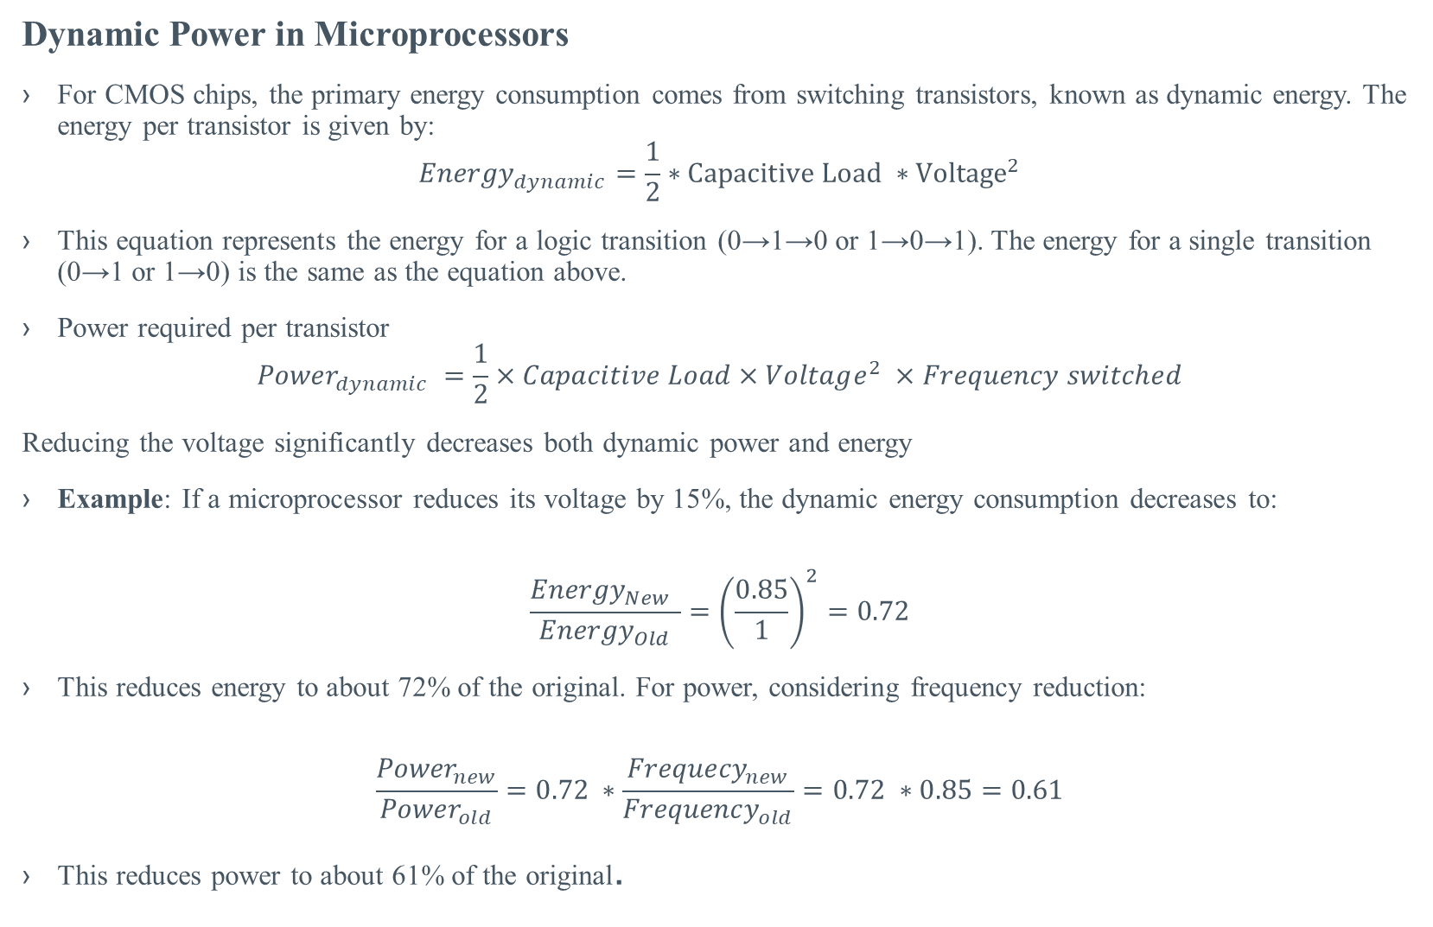
Dynamic Power in Microprocessors
For CMOS chips, the primary energy consumption comes from switching transistors, known as dynamic energy. The energy per transistor is given by:
$${Energy}_{dynamic}=\frac{1}{2}∗Capacitive Load ∗{Voltage}^{2}$$
This equation represents the energy for a logic transition (0→1→0 or 1→0→1). The energy for a single transition (0→1 or 1→0) is the same as the equation above.
Power required per transistor
$${Power}_{dynamic} =\frac{1}{2}×Capacitive Load×Voltage^{2} ×Frequency switched$$
Reducing the voltage significantly decreases both dynamic power and energy
Example: If a microprocessor reduces its voltage by 15%, the dynamic energy consumption decreases to:
$$\frac{{Energy}_{New }}{{Energy}_{Old}}={\left(\frac{0.85}{1}\right)}^{2}=0.72$$
This reduces energy to about 72% of the original. For power, considering frequency reduction:
$$\frac{{Power}_{new}}{{Power}_{old}}=0.72 ∗\frac{{Frequecy}_{new}}{{Frequency}_{old}}=0.72 ∗0.85=0.61$$
This reduces power to about 61% of the original.

Slide 17
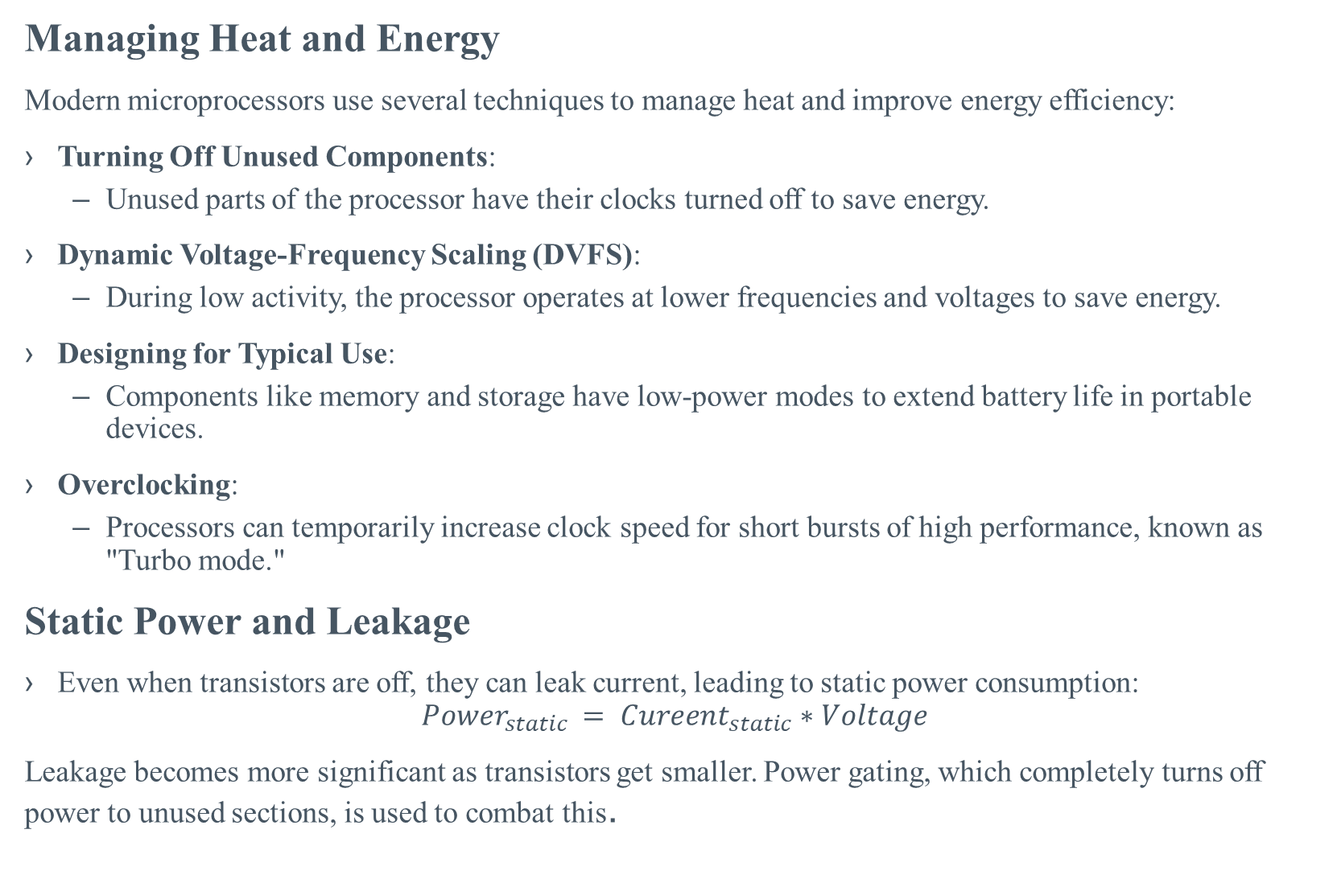
Managing Heat and Energy
Modern microprocessors use several techniques to manage heat and improve energy efficiency:
Turning Off Unused Components:
Unused parts of the processor have their clocks turned off to save energy.
Dynamic Voltage-Frequency Scaling (DVFS):
During low activity, the processor operates at lower frequencies and voltages to save energy.
Designing for Typical Use:
Components like memory and storage have low-power modes to extend battery life in portable devices.
Overclocking:
Processors can temporarily increase clock speed for short bursts of high performance, known as "Turbo mode."
Static Power and Leakage
Even when transistors are off, they can leak current, leading to static power consumption:
$${Power}_{static }= {Cureent}_{static}∗Voltage$$
Leakage becomes more significant as transistors get smaller. Power gating, which completely turns off power to unused sections, is used to combat this.

Slide 18
The Future of Energy-Efficient Design
As transistor improvements slow, architects are exploring domain-specific processors that perform specific tasks efficiently. This approach aims to balance performance and energy efficiency, potentially leading to a mix of general-purpose and specialized processors in future designs.

Slide 19
1.6Trends in Cost: Balancing Performance and Economics
While cost might not be the top priority for high-end systems like supercomputers, it's becoming increasingly important for most other computer designs. Over the past 35 years, the computer industry has focused on using technological advancements to not only boost performance but also to lower costs.
The Impact of Time, Volume, and Commoditization
Costs naturally decrease over time due to improvements in manufacturing processes, driven by the learning curve. This curve is all about increasing yield—the percentage of devices that pass testing. For example, the cost of DRAM has historically followed this trend, closely aligning with manufacturing costs.
Volume Production: Higher production volumes lead to lower costs due to increased efficiency in purchasing and manufacturing. A rule of thumb suggests that costs decrease by about 10% for each doubling of production volume.
Commoditization: When products like DRAM, flash memory, and monitors become standardized and are produced by many vendors, competition drives costs down further. This has been particularly evident in the personal computer industry.

Slide 20
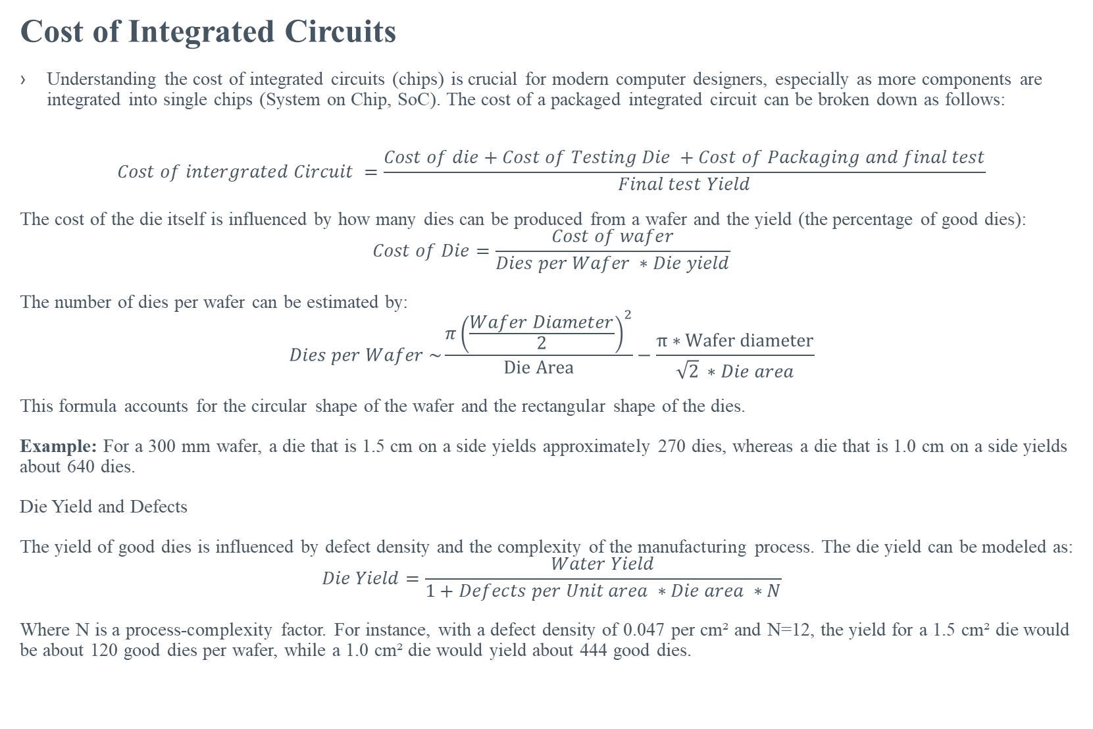
Cost of Integrated Circuits
Understanding the cost of integrated circuits (chips) is crucial for modern computer designers, especially as more components are integrated into single chips (System on Chip, SoC). The cost of a packaged integrated circuit can be broken down as follows:
$$Cost of intergrated Circuit =\frac{Cost of die+Cost of Testing Die +Cost of Packaging and final test}{Final test Yield}$$
The cost of the die itself is influenced by how many dies can be produced from a wafer and the yield (the percentage of good dies):
$$Cost of Die=\frac{Cost of wafer}{Dies per Wafer ∗Die yield}$$
The number of dies per wafer can be estimated by:
$$Dies per Wafer \sim \frac{π{\left(\frac{Wafer Diameter}{2}\right)}^{2}}{Die Area}−\frac{π∗Wafer diameter}{\sqrt{2} ∗Die area}$$
This formula accounts for the circular shape of the wafer and the rectangular shape of the dies.
Example: For a 300 mm wafer, a die that is 1.5 cm on a side yields approximately 270 dies, whereas a die that is 1.0 cm on a side yields about 640 dies.
Die Yield and Defects
The yield of good dies is influenced by defect density and the complexity of the manufacturing process. The die yield can be modeled as:
$$Die Yield=\frac{Water Yield}{1+Defects per Unit area ∗Die area ∗N}$$
Where N is a process-complexity factor. For instance, with a defect density of 0.047 per cm² and N=12, the yield for a 1.5 cm² die would be about 120 good dies per wafer, while a 1.0 cm² die would yield about 444 good dies.

Slide 21
Fixed Costs and Mask Sets
For low-volume production, the cost of a mask set—needed for each step in the manufacturing process—can be significant. Mask costs can be around $4 million for a 16 nm process. To mitigate this, semiconductor companies offer "shuttle runs," where multiple small designs share a wafer to spread the cost of the mask set.
Balancing Manufacturing and Operational Costs
In large-scale computing environments, like warehouse-scale computers (WSCs), operational costs (OPEX) are as important as the initial purchase costs (CAPEX). Power consumption and cooling infrastructure contribute significantly to these operational costs. Therefore, designing energy-efficient systems is crucial to managing overall costs effectively.

